Slide 1

Immersive Python Workshop
August 12-14, 2026
Day 3
8/14/2026
Access slides and shared links
https://bit.ly/ipw-aug26-github

Slide 2
Day 3 Schedule
12:30 PM | Welcome and final software installation check
12:45 PM | Divide into instruction tracks breakout rooms Geospatial Sentiment Analysis Data Visualization
1:30 PM | Break
1:40 PM | Continue work in separate tracks
2:30 PM | Break
2:40 PM | Instruction: GitHub and AI
3:55 PM | Complete Day 3 Assessment and Wrap Up

Slide 3

Attendance
Please sign add an X next to your name for day 3 using bit.ly link on the white board
Recorded attendance is required to claim the Introduction to Python: Working with Research Data
Please note you will also need to complete the day 3 post workshop survey to claim the badge

Slide 4
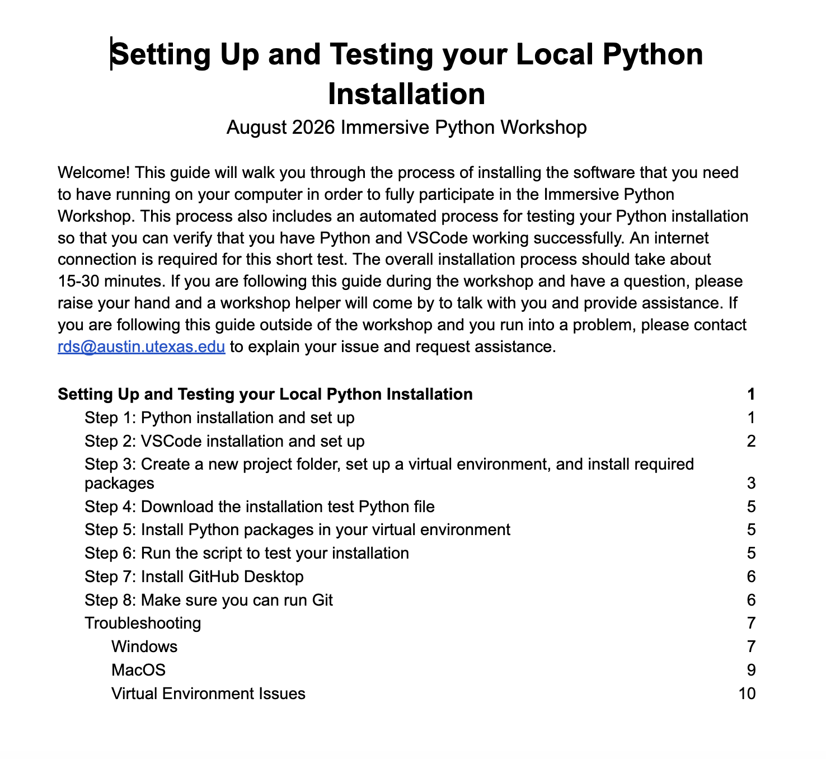
Final Check of Installed Software
Visit link below for detailed instructions for installing all required software
https://bit.ly/python-install-test-aug26
Installation test stats as of 10am this morning, for previous day attendees
Verified: 17
Not verified: 13
Even if your Python install was verified, please double check that you can run git via command line. The instructions have been slightly revised since yesterday.
Raise your hand if you need help or have questions

Slide 5
Track 1
Topic:
Data Visualization
Instructor:
Michael Shensky
Room:
Data Lab
Track 2
Topic:
Sentiment Analysis
Instructor:
Ian Goodale
Room:
Scholars Lab Project Room #6
Track 3
Topic:
Geospatial Data
Instructor:
Alex Marden
Room:
Scholars Lab Project Room #1

